Slide 1
Weekly Discovery Report 8
CycleSIGHT
Aiyana, Gloria, Farruh
CycleSIGHT: Because pain isn’t one-size-fits-all.

Slide 2
Clinical Focus
Sufficiently sampled our direct target market
Dissatisfaction with current menstrual pain remedies
Interest in understanding the biological side of NSAID use
Concerns: Data Privacy & Cost
Shift focus to surveying clinicians
Phone interviews with 3 clinicians (one from Planned Parenthood, 2 from Atrium Health Women’s Care), filled out survey for them based on their answers on the phone

Slide 3
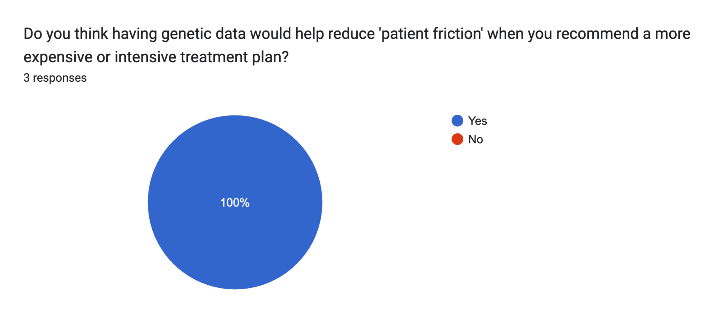

Slide 4
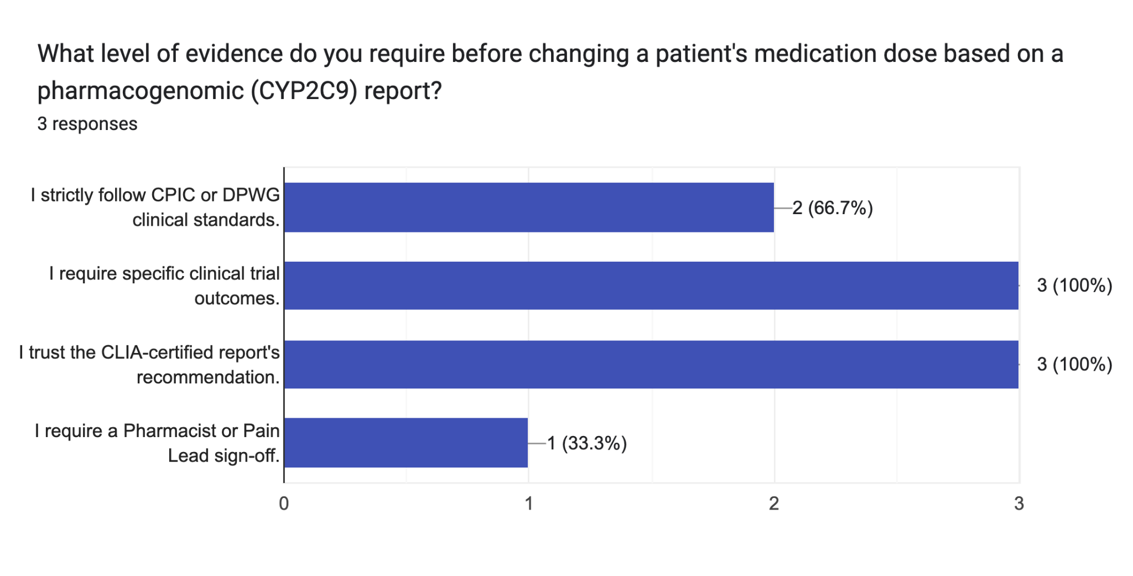

Slide 5
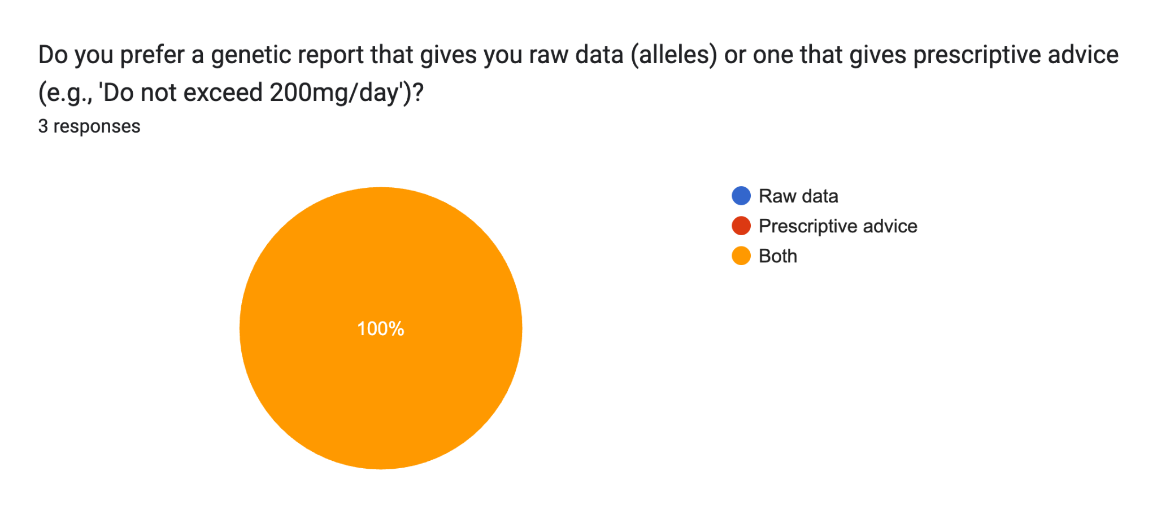

Slide 6
Thank you.

